Slide 1
Applying Machine Learning to Satellite Remote Sensing Data
Heather Hunter
Phd student
Applied marine physics
hhunter@miami.edu
Lunch Bytes
October 5, 2018

Slide 2
What we’ll cover…
The basics:
Math
From the Perceptron to Deep Learning
Practicalities:
What frameworks are available?
What models are useful for us?
What does the design cycle look like?
How do we prepare the data?
How do we train the model?

Slide 3
“Quick” Overview of Bayesian Decision Theory

Slide 4






Bayesian Decision Theory
Classes: classes drawn from random variable Y
$$Y_{fish}∈\left\{clown fish, blue tang\right\}$$
$$Y_{grades}∈\left\{A, B, C, D, F\right\}$$
$$Y_{diagnoses}∈\left\{disease A, disease B, …, disease N\right\}$$
Observer: measures features drawn from a random process X
$$X_{fish}=\left(color, length\right)∈ℝ^{2}$$
$$X_{grades}=\left({HW}_{1},{HW}_{2},…,{HW}_{n}\right)∈ℝ^{N}$$
$$X_{diagnoses}=\left({symptom}_{1},{symptom}_{2},…,{symptom}_{N}\right)∈ℝ^{N}$$
Notes:
The basic set concepts of this theory are: 1) the world has a certain number of states, or classes, drawn from a state or class random variable Y. We have an observer who measures observations, or features, drawn from a random process x

Slide 5





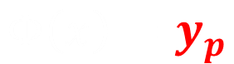
Bayesian Decision Theory
Decision function: use X to make decisions about Y
$$X∈Ω$$
$$Y∈Ψ$$
Mapping function
$$Φ: Ω→Ψ$$
$$Φ\left(x\right)=y_{p}$$
Prediction of Y based on X
Evaluate our decision:
$$L\left[y_{p},y\right]=\left\{\begin{aligned}1, y_{p}=y \\ &0, y_{p}≠y\end{aligned}\right.$$
$$L\left[y_{p},y\right]={\left\|y−y_{p}\right\|}^{2}$$
Notes:
The observer uses these observations of features X to make decisions about the classes, Y, using a decision function.
Given our prediction, we need to evaluate how good our decision was, so we use a loss function, which determines the cost of deciding for y_p when the true class or state is y (which would be 0 if there was no error, but more than 0, otherwise – AKA zero-one loss function). So ultimately, our goal is to determine the optimal decision function for this loss, which depends on the kind of problem we’re trying to solve.
Let’s say our observer wants to classify

Slide 6
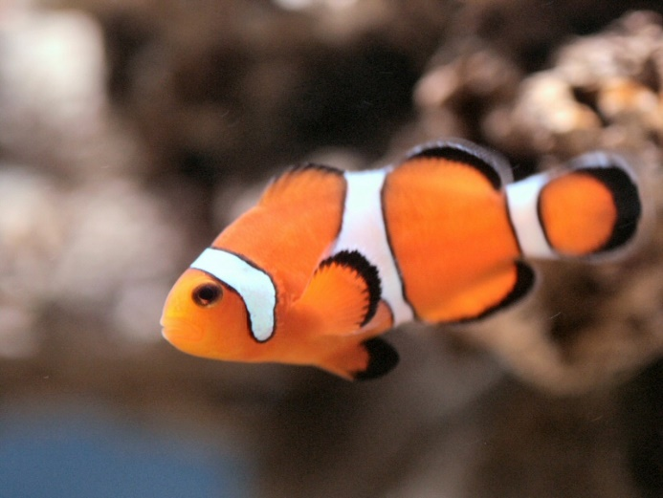
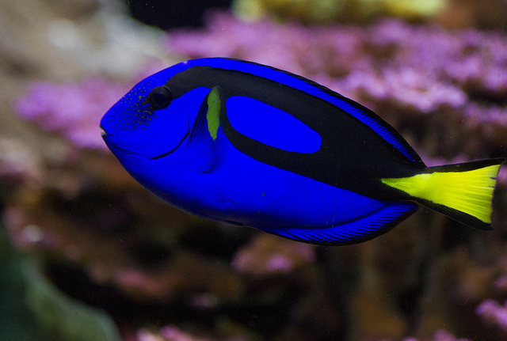


An Oversimplified Example: Assumptions
Our world contains only 2 classes of fish ($Y∈ℝ^{2}$):
Clown Fish
$$y_{1}$$
Blue Tang
$$y_{2}$$
Notes:
We assume our world contains only 2 classes of fish

Slide 7

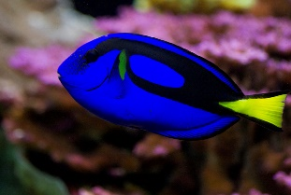










An Oversimplified Example: Priors
$$Y∈ℝ^{2}$$
Prior Probability: $P\left(y\right)$
(probability we’ll see either $y_{1}$ or $y_{2}$ in a given moment)
$$y_{1}$$
$$y_{2}$$
$$P\left(y_{1}\right)$$
$$P\left(y_{2}\right)$$
Equal numbers of $y_{1}$ and $y_{2}$
Numbers of $y_{1}$ and $y_{2}$ depend on weather
$$P\left(y_{1}\right)=P\left(y_{2}\right)$$
$$P\left(y_{1}\right)>P\left(y_{2}\right)$$
Notes:
Setting up the problem, we should identify what we know. In this case, we have prior probabilities, which reflect our prior knowledge of how likely we expect a certain class before we actually observe it.
Perhaps it’s equiprobable? Meaning we have equals numbers of both kinds of fish in this region we’re focused on. Or maybe under certain weather conditions, we know we’re going to have more of one than the other.

Slide 8
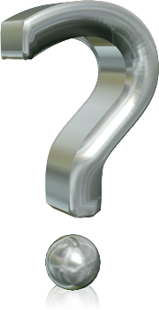


An Oversimplified Example: Decision Rule
$$Y∈ℝ^{2}$$
What action do we take based on the observations?
What would be a reasonable rule if we only used the prior probabilities?
$$y_{1}$$
$$y_{2}$$
$$P\left(y_{1}\right)$$
$$P\left(y_{2}\right)$$
$$y_{p}=\left\{\begin{aligned}y_{1}, P(y_{1})>P(y_{2}) \\ y_{2}, P(y_{2})>P(y_{1})\end{aligned}\right.$$
If $P\left(y_{1}\right)=90\%$ and $P\left(y_{2}\right)=10\%$, $y_{p}=y_{1}$
…we’ll always choose the same class
…can we use other information?
Notes:
Setting up the problem, we should identify what we know. In this case, we have prior probabilities, which reflect our prior knowledge of how likely we expect a certain class before we actually observe it.
Perhaps it’s equi-probable? Meaning we have equals numbers of both kinds of fish in this region we’re focused on. Or maybe under certain weather conditions, we know we’re going to have more of one than the other.

Slide 9



An Oversimplified Example: Decision Rule
$$Y∈ℝ^{2}$$
What action do we take based on the observations?
What would be a reasonable rule if we only used the prior probabilities?
include class-conditional information?
$$y_{1}$$
$$y_{2}$$
$$P\left(y_{1}\right)$$
$$P\left(y_{2}\right)$$
$$p\left(x | y_{j}\right)$$
probability function for x given that the class is $y_{j}$
Posterior Probability
probability of a certain class y given the observables, x
$$P\left(y | x\right)$$
Notes:
Then we want to find the posterior probability

Slide 10







An Oversimplified Example: Decision Rule
$$Y∈ℝ^{2}$$
What action do we take based on the observations?
$$P\left(y | x\right)=\frac{likelihood ×prior}{evidence}$$
$$y_{1}$$
$$y_{2}$$
$$P\left(y | x\right)=\frac{p\left(x | y\right)×P(y)}{p(x)}$$
$$P\left(y_{1}\right)$$
$$P\left(y_{2}\right)$$
Bayes’ Formula
$$p\left(x | y_{j}\right)$$
$If P\left(y_{1} \right| x)>P\left(y_{2} \right| x )$, then
$$y_{p}=y_{1}$$
$If P\left(y_{2} \right| x)>P\left(y_{1} \right| x )$, then
$$y_{p}=y_{2}$$
Notes:
Setting up the problem, we should identify what we know. In this case, we have prior probabilities, which reflect our prior knowledge of how likely we expect a certain class before we actually observe it.
Perhaps it’s equi-probable? Meaning we have equals numbers of both kinds of fish in this region we’re focused on. Or maybe under certain weather conditions, we know we’re going to have more of one than the other.

Slide 11



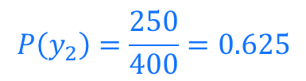
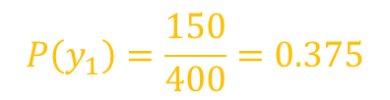

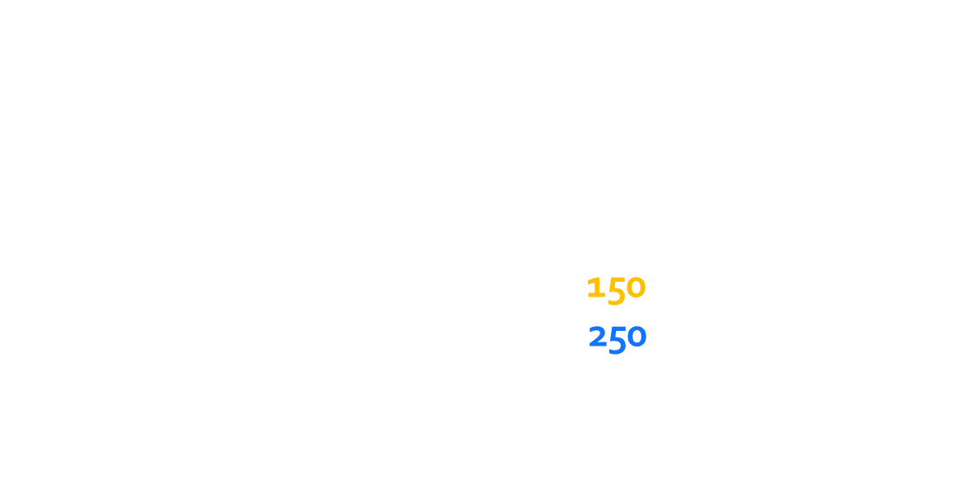
An Oversimplified Example:
$$Y∈ℝ^{2}$$
Collect Data:
Determine color of fish
Metadata:
Total number of samples (images): 400
Number of samples for $y_{1}$: 150
Number of samples for $y_{2}$: 250
Prior Probabilities:
$$y_{1}$$
$$y_{2}$$
Classes:
$y_{1}$, if Clown Fish
$y_{2}$, if Blue Tang
Feature:
$x_{c}$, color of the fish
$$P\left(y_{1}\right)=\frac{150}{400}=0.375$$
$$P\left(y_{2}\right)=\frac{250}{400}=0.625$$
Notes:
On the one hand, they can come from experiments, which is what we’ll focus on assuming all we care about is supervised learning.

Slide 12
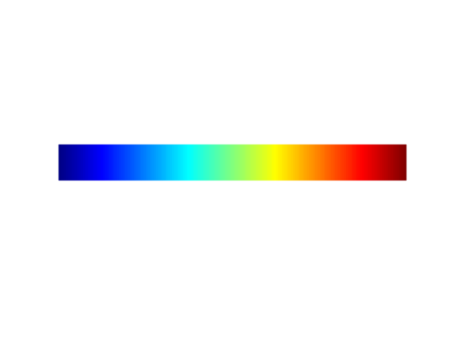




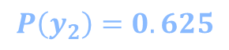
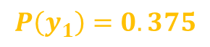

Putting it all together…
$$Y∈ℝ^{2}$$
Class Conditional Probabilities:
i.e.: what are the distributions of $x_{c}$ for $y_{1}$ and $y_{2}$?
$$y_{1}$$
$$y_{2}$$
Classes:
$y_{1}$, if Clown Fish
$y_{2}$, if Blue Tang
Feature:
$x_{c}$, color of the fish
$$y_{2}$$
Class Conditional Probability
$$p(x_{c}|y_{i})$$
$$y_{1}$$
$$P\left(y_{1}\right)=0.375$$
$$P\left(y_{2}\right)=0.625$$
Color (binned), $x_{c}$
Notes:
On the one hand, they can come from experiments, which is what we’ll focus on assuming all we care about is supervised learning.
From this you then calculate the posterior probabilities.

Slide 13

Feature Spaces and Decision Boundaries – Simplified
Large
decision boundary
2 features gives a 2-D feature space
Can we learn which part of the feature space belongs to which class?
SIZE
Example:
$x_{1}=$ Color
$x_{2}=$ Size
Small
COLOR
Notes:
Feature Spaces and Decision Boundaries -- Simplified

Slide 14

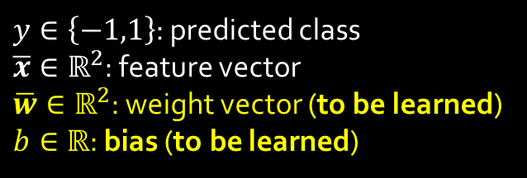


Linear Classifiers: The Perceptron
$$y>0$$
How do we define the line?
Large
$$y=sgn\left({\overline{w}}^{T}\overline{x}+b\right)$$
SIZE
Small
decision boundary
$y∈\left\{−1,1\right\}$: predicted class
$\overline{x}∈ℝ^{2}$: feature vector
$\overline{w}∈ℝ^{2}$: weight vector (to be learned)
$b∈ℝ$: bias (to be learned)
$$y<0$$
COLOR
Notes:
Points on 1 side of the plane belong to 1 class, and those on the other side belong to a different class, so…
Most often, the problem is NOT linearly separable, so we either need better features (maybe in a different feature space like wavelet space?), or a non-linear decision boundary

Slide 15
What if the decision boundary is not linear?
k-Nearest Neighbor (k-NN): find the k closest data points and make decision based on labels of the neighbors
(Random) Decision Trees:
iteratively divide feature space into search cells based on some rule
Random Forests: combination of decision trees
Notes:
How do we determine the decision boundary?

Slide 16
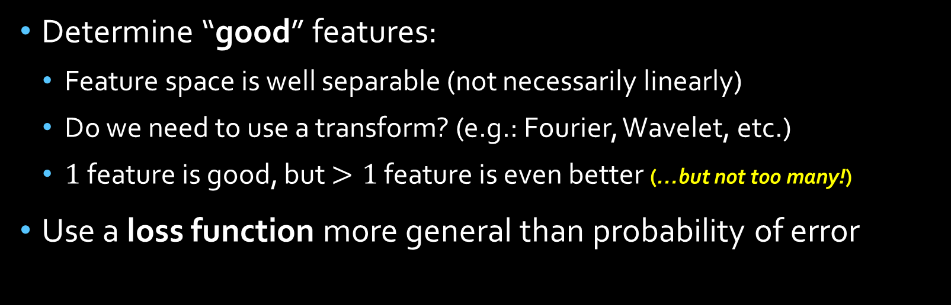
To Summarize:
or, “Things to think about as you design your solution”
Determine “good” features:
Feature space is well separable (not necessarily linearly)
Do we need to use a transform? (e.g.: Fourier, Wavelet, etc.)
$1$ feature is good, but $>1$ feature is even better (…but not too many!)
Use a loss function more general than probability of error
Notes:
Maybe we need to use a transform in order to make the feature space more clearly separable?

Slide 17
Machine Learning Tasks in Satellite Remote Sensing
“Vision” tasks
Object Classification
Object Detection
Scene Classification
Temporal tasks
Monitor evolution of a feature over time

Slide 18
Useful Machine Learning Algorithms for Remote Sensing Problems

Slide 19
Common Algorithms
Decision Trees
Support Vector Machines
Artificial Neural Networks
Convolutional Neural Networks
Fully Convolutional Networks
Residual Networks
Autoencoders
Recurrent Neural Networks
Long Short-Term Memory Neural Networks
“Feature Learning”

Slide 20
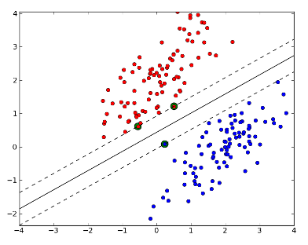
Support Vector Machines (SVMs)
Learns the optimal decision plane that separates classes
Kernel functions: map from input space to feature space
Faster than MLPs/CNNs and require fewer training samples
No direct multi-class classification
Example use in oceanography:
SVM and random forest classifier to 1) identify eddy cores, and 2) determine the polarity of detected eddies

Slide 21
Recurrent Neural Networks (RNNs)
RNNs are sequential models
Learn patterns in sequential data
Input data is a time-series with short-term dependences
Change detection
Short-term dynamics
“Memory”
Neural network with feedback loop
Information extracted from previous examples is preserved

Slide 22
RNNs: Long Short Term Memory (LSTM)
“forget gate”
Learn longer-term dependencies
Decide what new information to store

Slide 23

“Deep Learning”?
The New Hotness
“Deep” simply means “more than one hidden layer”
Performs feature learning
Automatically learn features at multiple scales
Possible to extract these features and use them with other classifiers
Used by: Facebook, Google, Amazon, …

Slide 24

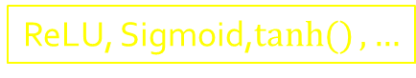
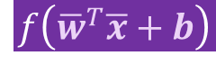









MLP Building Blocks
Input:
Feature Vector of N features
$$x_{1}$$
$$x_{2}$$
$$x_{3}$$
:
$$x_{n}$$
$$w_{1}$$
$$x=\left\{x_{1},x_{2},…,x_{n}\right\}$$
$$w_{2}$$
Neuron
$$x_{1}$$
$$w_{3}$$
Output
$$\begin{matrix}x_{1}^{1} \\ x_{1}^{2} \\ x_{1}^{3}\end{matrix}$$
$$f\left({\overline{w}}^{T}\overline{x}+b\right)$$
M number of samples
$$w_{n}$$
$$\begin{matrix}x_{1}^{4} \\ : \\ x_{1}^{m}\end{matrix}$$
Activation Function
(maps the linear function to a non-linear function)
$$x∈ℝ^{NxM}$$
ReLU, Sigmoid,$\tanh{()}, …$
Notes:
We start with the neuron, the fundamental building block of an MLP. The neuron transforms the linear function to a non-linear function to allow for more complex solutions
The activation function maps the neuron’s value (a weighted sum of the input features)
Add satellite image example

Slide 25
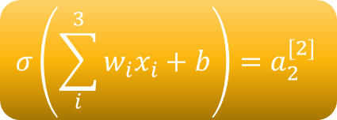
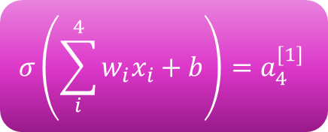
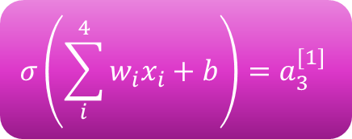
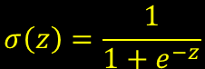
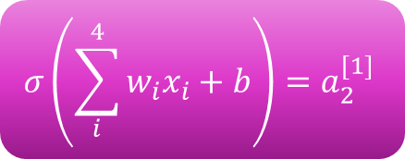

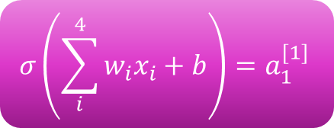



Fully-Connected MLP Example
Overview:
4 features
3 layers
2 classes
sigmoid activation function
$$σ\left(\sum_{i}^{4}{w_{i}x_{i}}+b\right)=a_{1}^{[1]}$$
$$σ\left(z\right)=\frac{1}{1+e^{−z}}$$
$$x_{1}$$
$$x_{2}$$
$$x_{3}$$
$$x_{4}$$
$$σ\left(\sum_{i}^{4}{w_{i}x_{i}}+b\right)=a_{2}^{[1]}$$
$$σ\left(\sum_{i}^{3}{w_{i}x_{i}}+b\right)=a_{2}^{[2]}$$
$${\hat{y}}_{1}$$
$$σ\left(\sum_{i}^{4}{w_{i}x_{i}}+b\right)=a_{3}^{[1]}$$
$$σ\left(\sum_{i}^{3}{w_{i}x_{i}}+b\right)=a_{3}^{[2]}$$
$${\hat{y}}_{2}$$
$$σ\left(\sum_{i}^{4}{w_{i}x_{i}}+b\right)=a_{4}^{[1]}$$
Output Layer
Input Layer
Hidden Layer 1

Slide 26

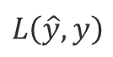
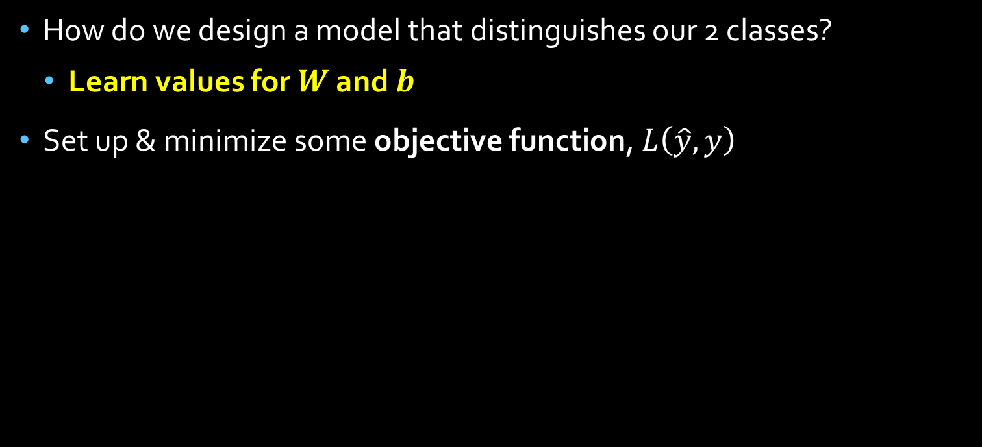



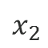

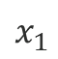

Training
How do we design a model that distinguishes our 2 classes?
Learn values for $W$ and $b$
Set up & minimize some objective function, $L\left(\hat{y}, y\right)$
$$x_{1}$$
$$w_{1}$$
Actual
$$w_{2}$$
Predicted
$$y$$
$$x_{2}$$
=
$$\hat{y}$$
$$w_{n}$$
$$x_{n}$$
Hidden Layer 1
Output Layer
Objective function
$$L\left(\hat{y}, y\right)$$
Update weights & biases (W, b)
Backpropagation
Notes:
Objective function also called loss function or an energy function. It will iteratively determine the error between the actual result and our predicted result. Our goal is to minimize this function.
Back-propagation uses the results of the forward pass (where we compute our predictions and training loss) and updates the values of the weights and biases until the objective is minimized.

Slide 27
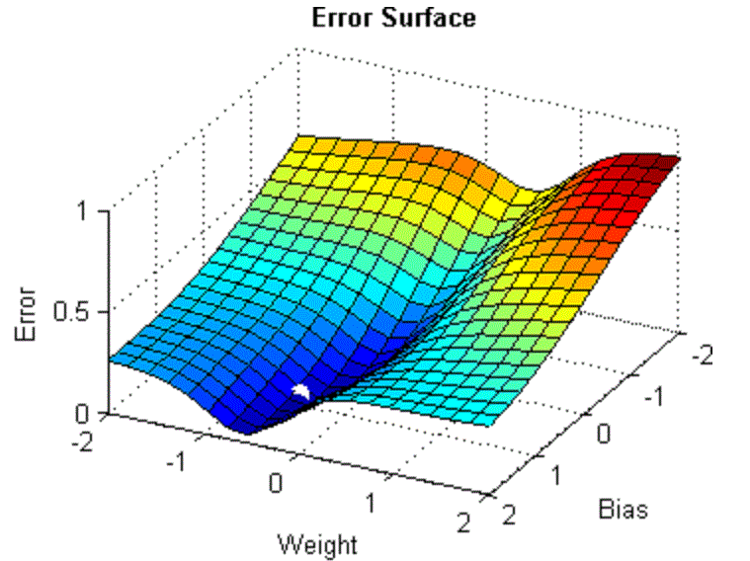
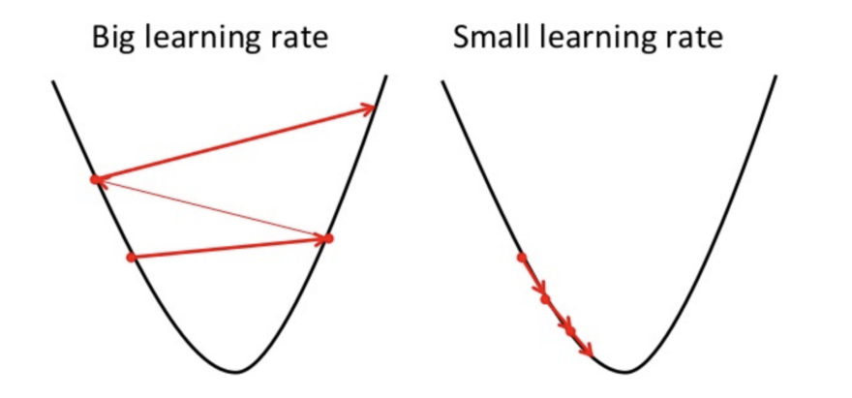

Training
Objective function defines training loss
Many ways to minimize: usually stochastic gradient descent
Learning rate defines how large or small steps are to get to minimum
$$\frac{δL}{δa^{l}}$$
Notes:
Objective function also called loss function. It will iteratively determine the error between the actual result and our predicted result. Our goal is to minimize this function.

Slide 28
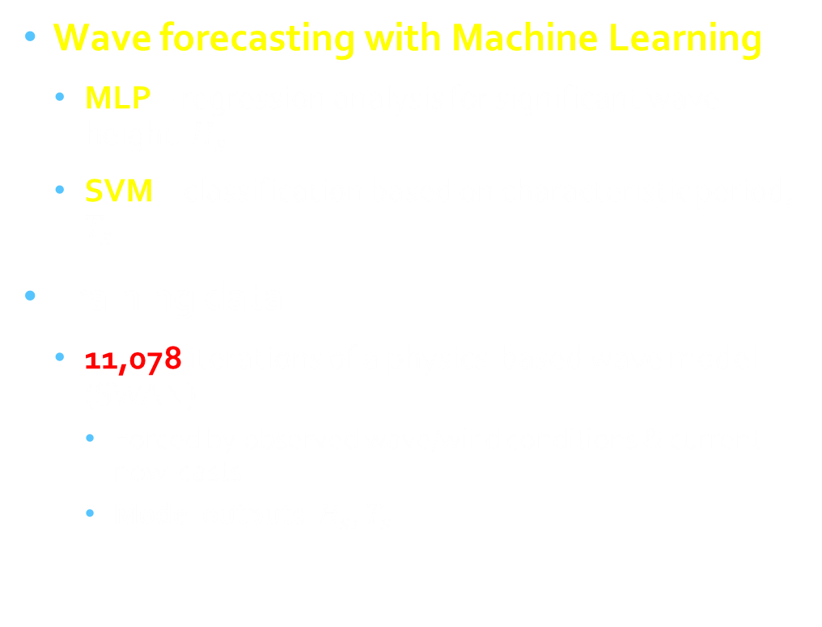
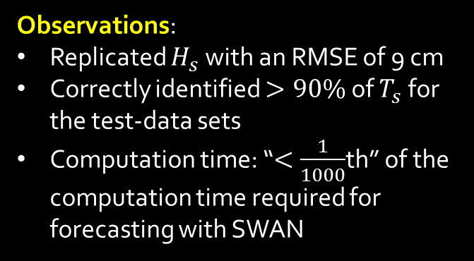
Oceanographic Example
Wave forecasting with Machine Learning
MLP – regression analysis for significant wave height, $H_{s}$
SVM – classification based on characteristic period, $T_{s}$
Training data:
11,078 iterations of a physics-based wave model (SWAN)
Forced by observed wave/wind conditions & current now-casts
Model outputs: $H_{s}$, $T_{s}$
Observations:
Replicated $H_{s}$ with an RMSE of 9 cm
Correctly identified $>90\%$ of $T_{s}$ for the test-data sets
Computation time: “$<\frac{1}{1000}$th” of the computation time required for forecasting with SWAN
Notes:
Assumes steady-state conditions

Slide 29
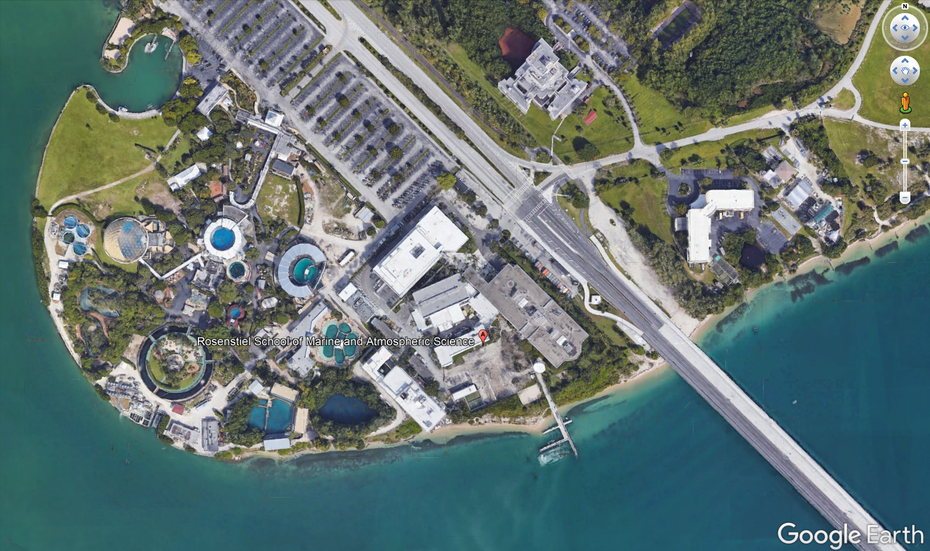
From MLPs to CNNs:
Depending on the task, an MLP may not be appropriate solution
Hidden Layer 1
Output Layer
Notes:
Multiple layers of units
Fully connected layers is a problem: too many parameters! A tremendous number of parameters in the case of images, which makes training computationally expensive
What’s a better way?

Slide 30
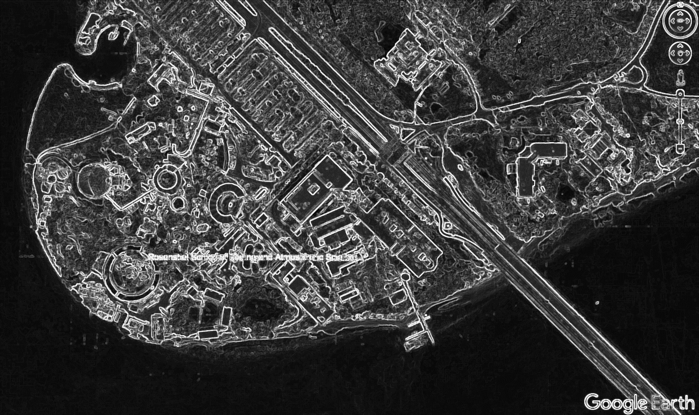

Convolutional Neural Networks (CNNs)
Designed specifically for 2-dimensional data sets (images)
“kernel”, filter, “receptive field”
Example: Sobel Kernel for edge detection
$$G_{x}=\left[\begin{matrix}1 & 0 & −1 \\ 2 & 0 & −2 \\ 1 & 0 & −1\end{matrix}\right]$$
Notes:
I’m not going to go over the basics of 2-D convolution, and I’m going to assume you understand, but in image processing, a convolution performs a filtering operation, depending on the type of kernel you choose. For example, the kernel for an edge detection filter called a Sobel operator looks like this, and would detect edges in each window, 3 x 3. A dot product is performed between the Kernel and each region of the image.

Slide 31
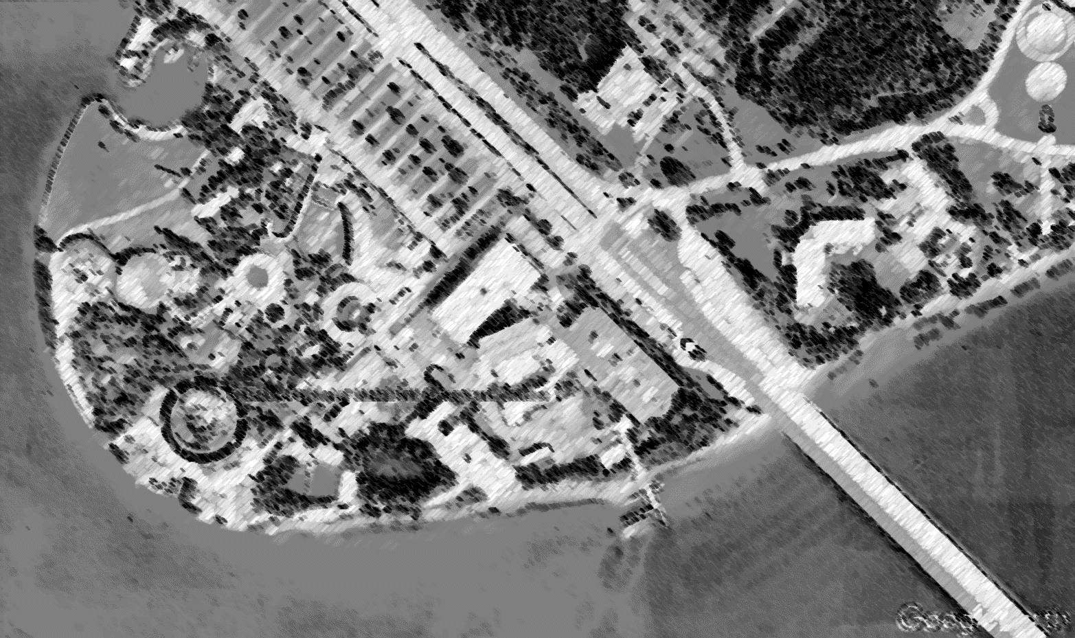
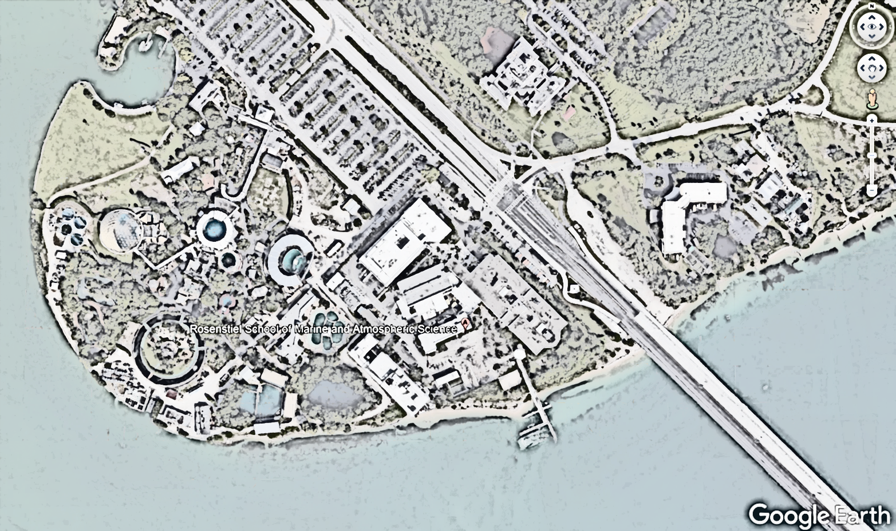
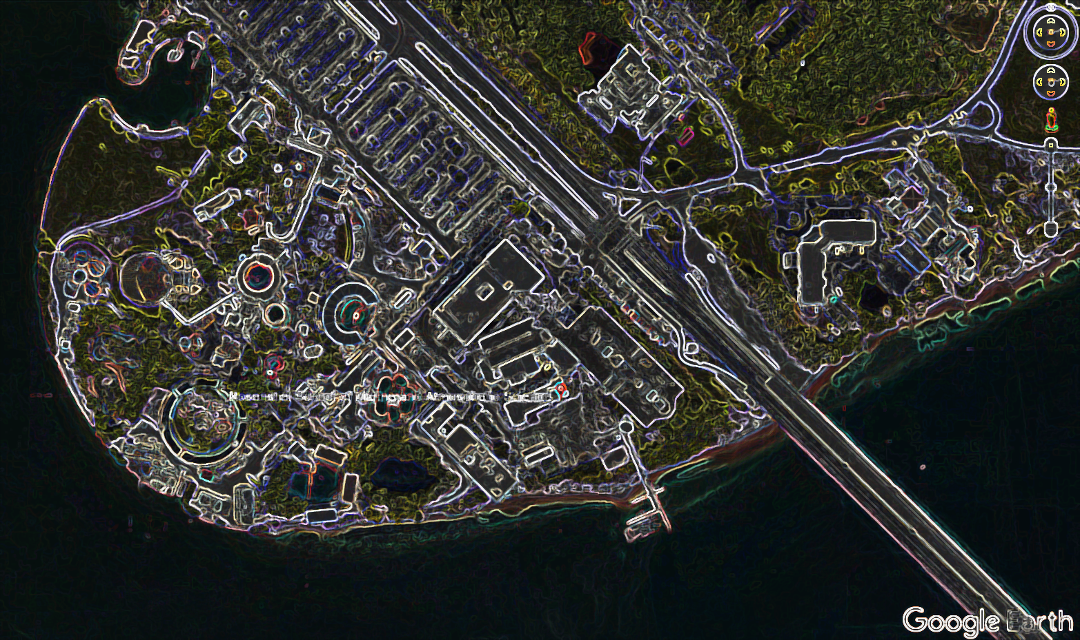
Convolutional Neural Networks (CNNs)
No feature development required
Each convolutional layer generates feature maps
3 feature maps
3 filters
Convolutional Layer 1
Neurons
(with Weights and Biases)
Notes:
I’m not going to go over the basics of 2-D convolution, and I’m going to assume you understand, but in image processing, a convolution performs a filtering operation, depending on the type of kernel you choose. For example, the kernel for an edge detection filter called a Sobel operator looks like this, and would detect edges in each window, 3 x 3.

Slide 32
Convolutional Neural Networks (CNNs)
Each layer learns increasingly complex features
Previous output
Downsampling
Convolutional Layer 2
Notes:
Downsampling layers reduces the resolution to save computational time and space. Since it does perform downsampling, you have to be careful how many downsampling layers you include and be sure to place them strategically.

Slide 33
Typical CNN Architecture: Object or Scene Classification
LAYER
PARAMETERS
Input Layer
INPUT = [ WIDTH, HEIGHT, # CHANNELS, # SAMPLES ]
e.g.:
[ 64, 64, 3, 200 ]
[ 64, 64, 1, 200 ]
RGB
GRAY
Conv. Layer 1
N number of filters – how many different features should be learned at this resolution?

Slide 34
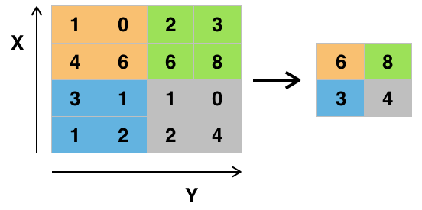


Typical CNN Architecture: Object or Scene Classification
LAYER
PARAMETERS
Conv. Layer 1
Activation layer, or nonlinear layer:
In CNNs, it’s usually the Rectified Linear Unit (ReLU):
$$f\left(x\right)=\max_{}{(0,x)}$$
Activation Layer
All negative activations go to 0
No adjustable parameters
Pooling layer, or downsampling layer:
Pooling Layer
Applies an operation $M×M$ filter to CNN+ReLU output
Most popular: max pooling
Notes:
The intuitive reasoning behind this layer is that once we know that a specific feature is in the original input volume (there will be a high activation value), its exact location is not as important as its relative location to the other features. As you can imagine, this layer drastically reduces the spatial dimension (the length and the width change but not the depth) of the input volume. This serves two main purposes. The first is that the amount of parameters or weights is reduced by 75%, thus lessening the computation cost. The second is that it will control overfitting. This term refers to when a model is so tuned to the training examples that it is not able to generalize well for the validation and test sets. A symptom of overfitting is having a model that gets 100% or 99% on the training set, but only 50% on the test data.

Slide 35
Typical CNN Architecture: Object or Scene Classification
LAYER
PARAMETERS
Conv. Layer 1
Fully Connected Layer:
N dimensional layer, where N is the number of classes
Outputs probabilities that input belongs to one of these classes
Activation Layer
Pooling Layer
Example Problem: Digit Classification
N: 10
[Repeat previous 3 layers]
0 0.1 0.1 0.75 0 0 0 0 0 0.05
Fully Connected Layer
Notes:
This layer basically takes an input volume (whatever the output is of the conv or ReLU or pool layer preceding it) and outputs an N dimensional vector where N is the number of classes that the program has to choose from.

Slide 36
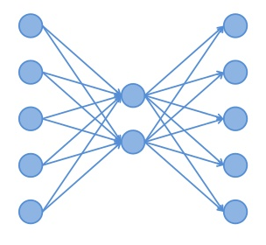

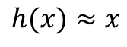

Autoencoders
An unsupervised learning algorithm
Goal: learn how to set the target values to be equal to the inputs
I.E.: learn an approximation to the identity function
$$x_{i}∈ℝ^{N}$$
$$y_{i}∈ℝ^{N}$$
Why is this useful?
Constrain hidden layer to have fewer nodes than input
Learn a compressed representation of the input
Similar to principal components analysis
$$h(x)≈x$$

Slide 37
Frameworks
Or, don’t build the building blocks from scratch

Slide 38
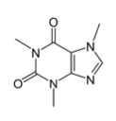
Caffe (UC Berkeley)
Convert data to CAFFE format (e.g.: list of images, .MAT file, .HDF5…)
“deep learning framework made with expression, speed, and modularity in mind”
Backend in C++
Interfaces with:
Python
MATLAB
Easily switch between CPU and GPU
Plenty of pre-trained models
Perform end-to-end learning for many tasks
Define the network
Configure the solver
http://caffe.berkeleyvision.org/
TRAIN

Slide 39

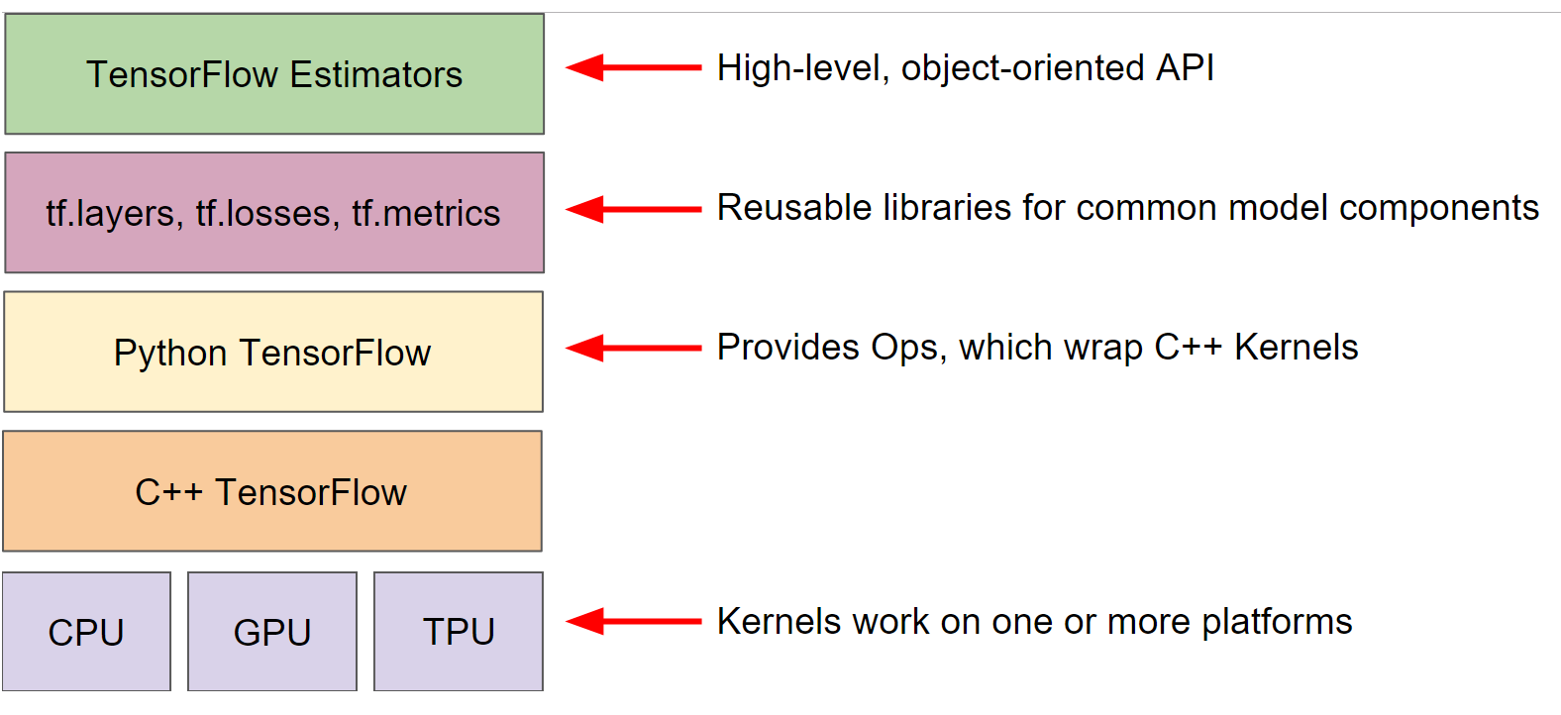
TensorFlow (GoogleBrain)
“open source software library [machine learning framework] for high performance numerical computation”
Can run on multiple CPUs and GPUs
Construct models at your preferred level of abstraction
Visualization/training monitoring capabilities via Tensorboard
Develop models for production
https://www.tensorflow.org/tutorials/

Slide 40

MATLAB (MathWorks)
“Using MATLAB®, engineers and other domain experts have deployed thousands of applications for predictive maintenance, sensor analytics, finance, and communication electronics.”
Like the others:
CPU/GPU
Pre-trained models
End-to-end learning
So many toolboxes
Image Processing , Signal Processing, Statistics & Machine Learning, Deep Learning, Computer Vision, Parallel Computing …
C/C++ for embedded applications

Slide 41

PyTorch
“Open source deep learning platform [for Python] that provides a seamless path from research prototyping to production deployment”
Tensor computation with strong GPU acceleration
Interfaces with C++ and Python
Many pre-trained models
https://pytorch.org/tutorials/

Slide 42
Practicalities
A workflow FOR supervised training

Slide 43
Pattern Recognition System Design Cycle
Collect Data
Choose Features
(or not?)
Choose Model
Train Model
Evaluate Model
Notes:
What feautres you choose depend on the characteristics of the problem domain
What model you select mainly depends on the characteristics of the problem domain as well
So many options, but you should also consider speed, memory, scalability of training data, ease of implementation, ease of hyperparameter training
In the end, it is a cycle because as you evaluate your model, you’ll find you will need to perform educated tweaks to other parts of the this cycle

Slide 44
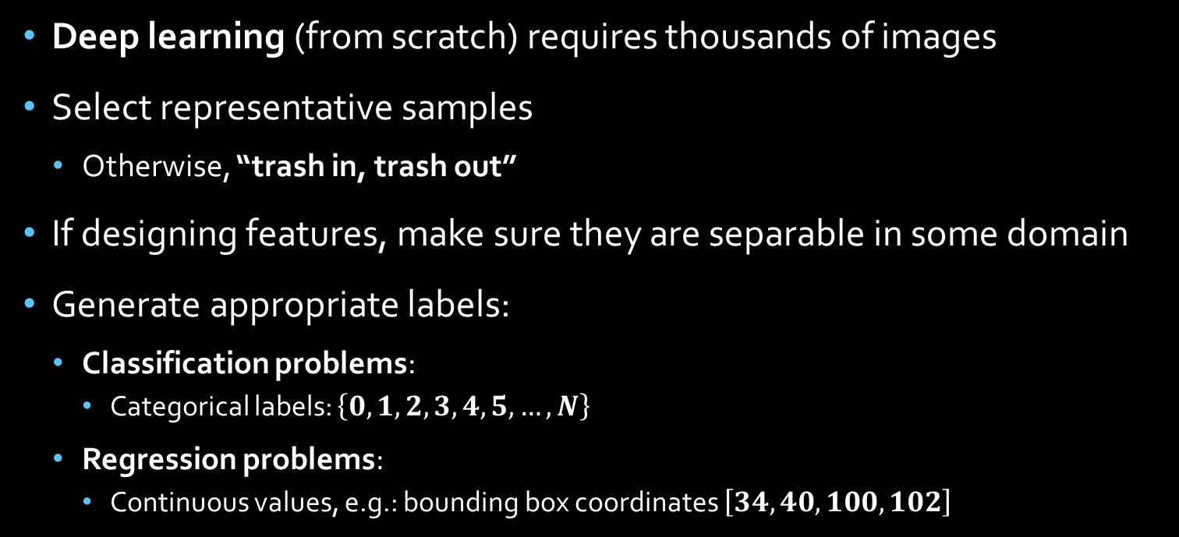
Selecting Data
Deep learning (from scratch) requires thousands of images
Select representative samples
Otherwise, “trash in, trash out”
If designing features, make sure they are separable in some domain
Generate appropriate labels:
Classification problems:
Categorical labels: $\left\{0, 1, 2, 3, 4, 5, …, N\right\}$
Regression problems:
Continuous values, e.g.: bounding box coordinates $\left[34, 40, 100, 102\right]$

Slide 45
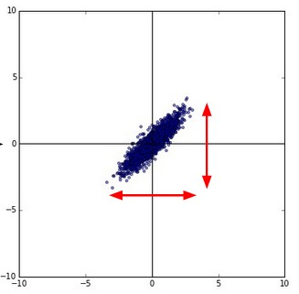
Data Preprocessing
Mask Clouds/Land
Noise Reduction
Data Preprocessing
Subtract mean
Normalize
Notes:
Especially important when working with satellite remote sensing data

Slide 46

Training, Validation, Test Data
Set aside some of your data for validation and test
K-fold cross validation
Example:
$$k=5$$
Full Data Set
Exp. 1
Training
Validation/Test
Validation/Test
Validation/Test
Validation/Test
Exp. 2
Validation/Test
Training
Validation/Test
Validation/Test
Validation/Test
Exp. 3
Validation/Test
Validation/Test
Training
Validation/Test
Validation/Test

Slide 47
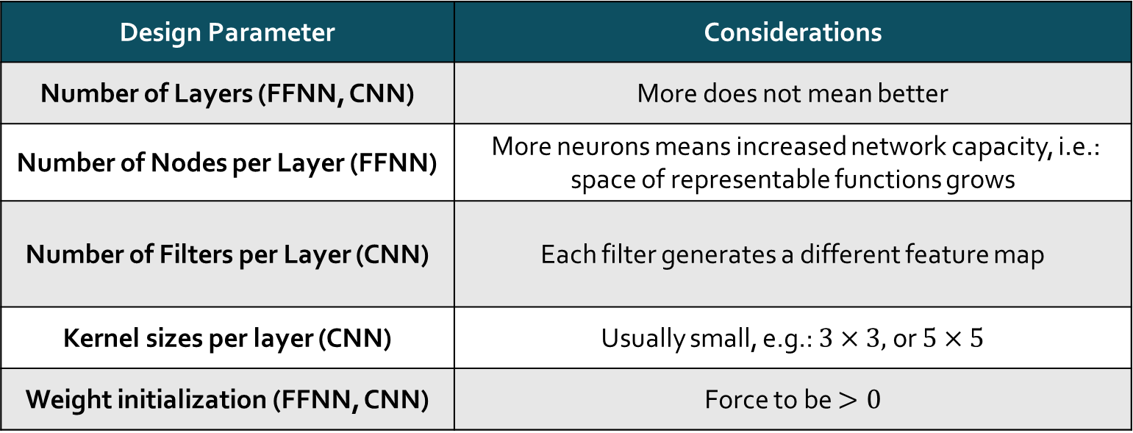
Set Up Model Parameters
Design Parameter | Considerations
Number of Layers (FFNN, CNN) | More does not mean better
Number of Nodes per Layer (FFNN) | More neurons means increased network capacity, i.e.: space of representable functions grows
Number of Filters per Layer (CNN) | Each filter generates a different feature map
Kernel sizes per layer (CNN) | Usually small, e.g.: $3×3,$or $5×5$
Weight initialization (FFNN, CNN) | Force to be $>0$

Slide 48

General Rule for Designing CNNs
The output size of a convolutional layer is given by:
Optional Parameter
Usually = 0
$$Conv Layer Output Size=\left(\frac{Input Size−Filter Size+(2×Padding Size)}{Stride Size}\right)+1$$
Optional Parameter
Usually = 1
The output size of a pooling layer is given by:
$$Pooling Layer Output Size=\left(\frac{Input Size}{Stride Size}\right)$$
Optional Parameter
Usually = 2

Slide 49
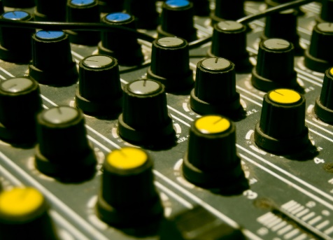
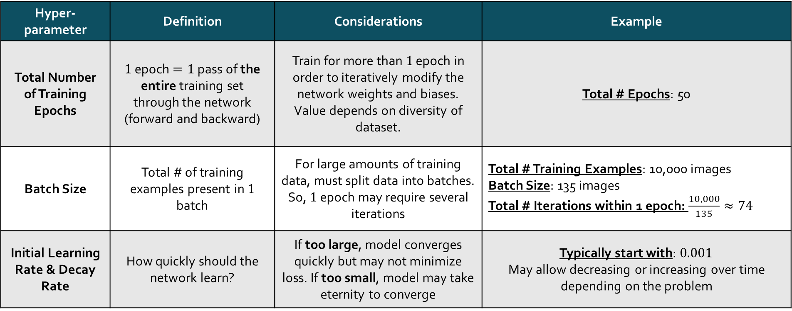
Set Training Hyper-parameters
Hyper-parameter | Definition | Considerations | Example
Total Number of Training Epochs | $1$ epoch $=1$ pass of the entire training set through the network (forward and backward) | Train for more than $1$ epoch in order to iteratively modify the network weights and biases. Value depends on diversity of dataset. | Total # Epochs: 50
Batch Size | Total # of training examples present in $1$ batch | For large amounts of training data, must split data into batches. So, $1$ epoch may require several iterations | Total # Training Examples: 10,000 images Batch Size: 135 images Total # Iterations within 1 epoch: $\frac{10,000}{135}≈74$
Initial Learning Rate & Decay Rate | How quickly should the network learn? | If too large, model converges quickly but may not minimize loss. If too small, model may take eternity to converge | Typically start with: $0.001$ May allow decreasing or increasing over time depending on the problem
Notes:
Typically the statistics learned for a small batch of the training set will be the same over the whole training set

Slide 50
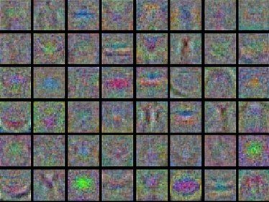
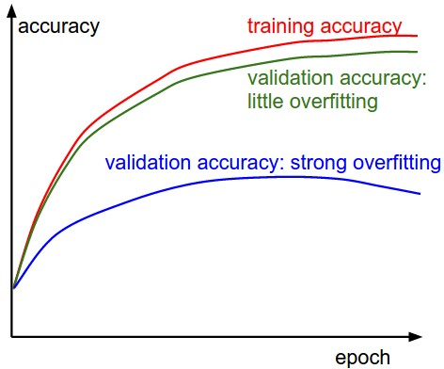

Monitor Training Progress
What you should be monitoring:
Values of the loss function over time
Training accuracy
Validation accuracy
Layer activations (for images)
Source of images:
http://cs231n.github.io/neural-networks-3/

Slide 51
Overfitting
Symptom: training accuracy is much higher than the validation accuracy
Cause: The model has learned the data, including the noise, not the underlying function
Solutions:
Data augmentation on training data set
Add new training samples
Add regularization → term that penalizes complex solutions
L1 or L2 Regularization
“Dropout”
Reduce network complexity
Normalization layer after each convolutional layer
Notes:
1. Adjust images: rotate, flip horizontally, flip vertically – but there’s a caveat to this. You have to be careful when considering the imaging geometry.

Slide 52
Underfitting
Symptom: both training and validation accuracies are low
Cause: the model can neither model the training data nor generalize to new data
Solution: try a different model

Slide 53
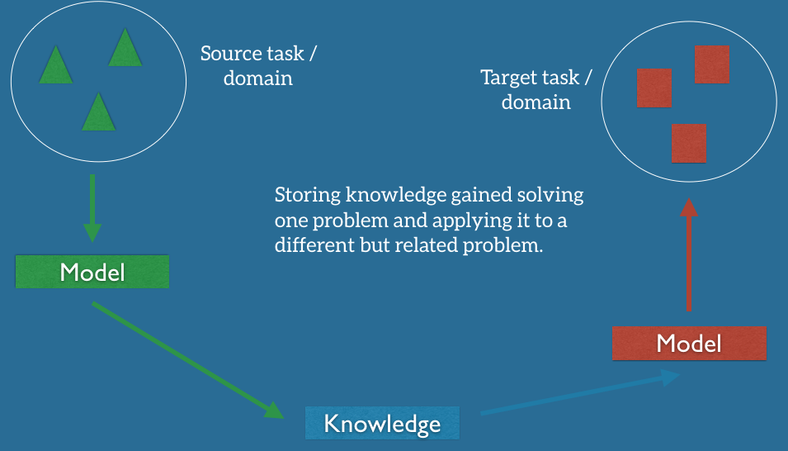
Transfer Learning
“Don’t be the hero…”
In deep learning, use pre-trained networks when possible
Transfer weights learned in a pre-trained network to your network
AlexNet
VGG-16/-19
ResNet-50/-100
GoogLeNet
Sebastian Ruder: http://ruder.io/transfer-learning/

Slide 54
Thank you!

Slide 55
Useful Resources from the Web
http://www.coursera.org (Andrew Ng from Stanford has plenty of courses here)
Stanford’s “Convolutional Neural Networks for Visual Recognition” course by Andrew Ng: http://cs231n.github.io/
https://developers.google.com/machine-learning/crash-course/

Slide 56
Useful Papers
Xiao Xiang. Zhu, Devis Tuia, Lichao Mou, Gui-Song Xia, Liangpei Zhang, Feng Xu, and Friedrich Fraundorfer. Deep Learning in Remote Sensing: A Comprehensive Review and List of Resources. IEEE Geoscience and Remote Sensing Magazine, December 2017.
Deep Learning for Remote Sensing Data. Liangpei Zhang, Lefei Zhang, Bo Du. IEEE Geoscience and Remote Sensing Magazine, June 2016.
ImageNet Classification with Deep Convolutional Neural Networks. Alex Krizhevsky, Ilya Sutskever, and Geoffrey E. Hinton. Advances in Neural Information Processing Systems, pp. 1097-1105. 2012.
Lichao Mou, Pedram Ghamisi, and Xiao Xiang Zhu. Deep Recurrent Neural Networks for Hyperspectral Image Classification. IEEE Transactions on Geoscience and Remote Sensing, Vol. 55, No. 7, July 2017.
Learning Spectral-Spatial-Temporal Features via a Recurrent Convolutional Neural Network for Change Detection in Multispectral Imagery. Submitted to IEEE Transactions on Geoscience and Remote Sensing, 2018.
Prediction of Sea Surface Temperature Using Long Short-Term Memory. Qin Zhang, Hui Wang, Junyu Dong, Guoqiang Zhong, and Xin Sun. IEEE Geoscience and Remote Sensing Letters, Vol. 14, Issue 10, October 2017.
Deep Residual Learning for Image Recognition. Kaiming He, Xiangyu Zhang, Shoqing Ren, and Jian Sun. IEEE Conference on Computer Vision and Pattern Recognition (CVPR), December 2016.
Evaluation of tree creation methods within random forests for classification of PolSAR images. Ronny Hansch and Olaf Hellwich. IEEE International Geoscience and Remote Sensing Symposium (IGARSS) 2015, pages 361-364.
A Survey on Gaussian Processes for Earth-Observation Data Analysis: A Comprehensive Investigation. Gustau Camps-Valls, Jochem Verrelst, Jordi Munoz-Mari, Valero Laparra, Fernando Mateo-Jimenez, and Jose Gomez-Dan. IEEE Geoscience and Remote Sensing Magazine, June 13 2016.

